Slide 1
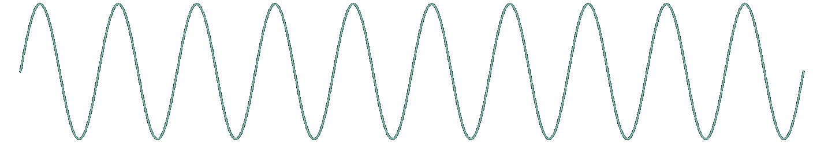
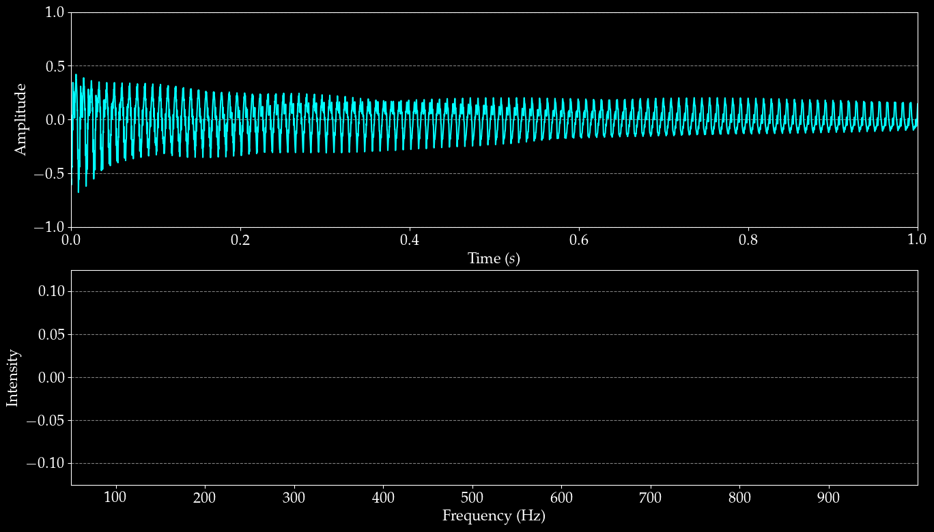

Musical sounds are just a bunch of sinusoidal waves added together
???????
But how do we find out which sine waves are in this sound?

Slide 2
Given a complex musical signal:
And a sinusoidal wave of some frequency θ
Is this wave a component of our original signal?
If so, what is its amplitude?

Slide 3
I am going to talk to you at length about the Inner Product
I swear this will most likely be a novel perspective I know there’s ten million videos on the Fourier transform but I haven’t seen this one made yet. trust me, okay

Slide 4

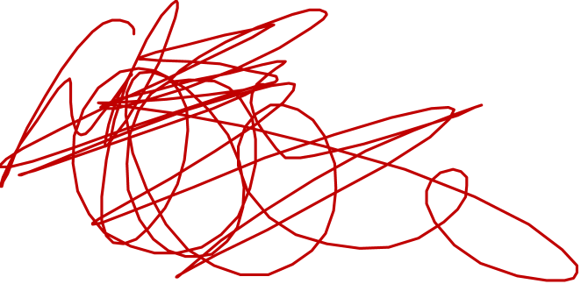
The Inner Product
Take the area
Under this curve
Notes:
\mathrm{For\ functions\ } f(t)&,\ g(t) \mathrm{\ defined\ on\ } t\in[0, L]: \\
\langle f, g \rangle &= \int_{0}^{L} f(t) g(t) dt \\
\\
\langle f, g \rangle &= \langle g, f \rangle \\
\langle \alpha f, g \rangle &= \alpha \langle f, g \rangle \\
\langle f, f \rangle &\geq 0 \\
\langle h + f, g \rangle &= \langle f, g \rangle + \langle h, g \rangle \\

Slide 5
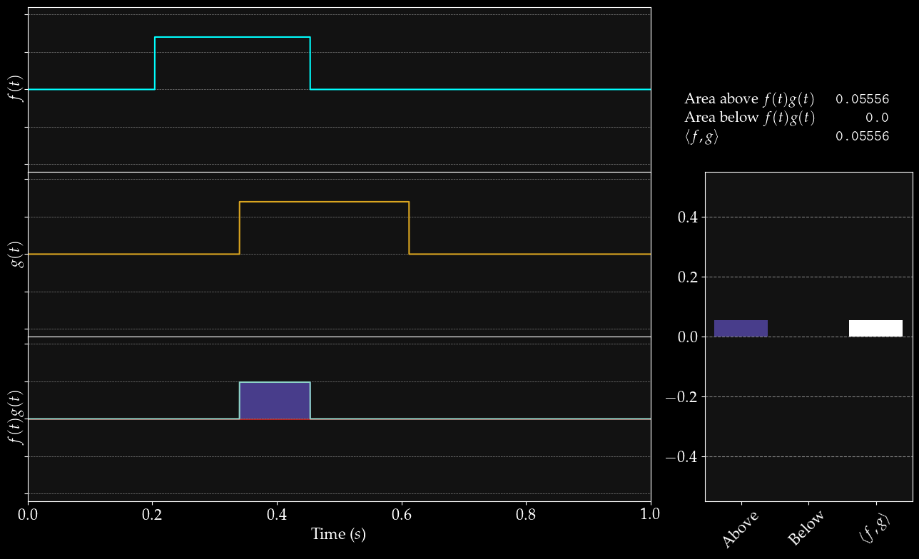
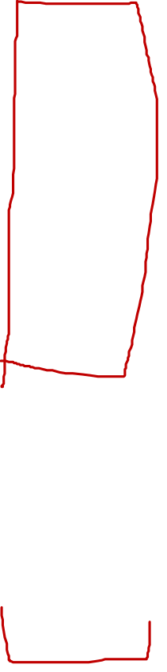

Slide 6
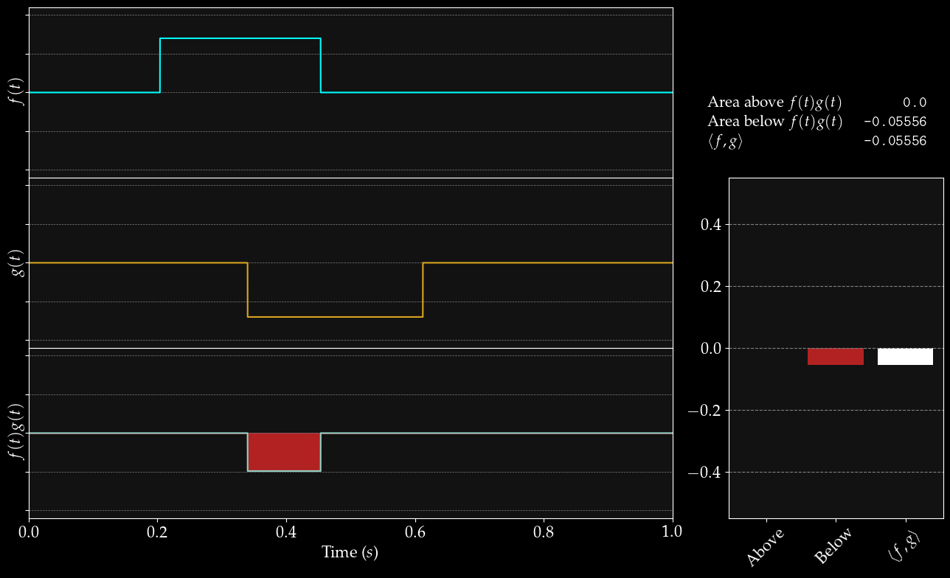

Slide 7
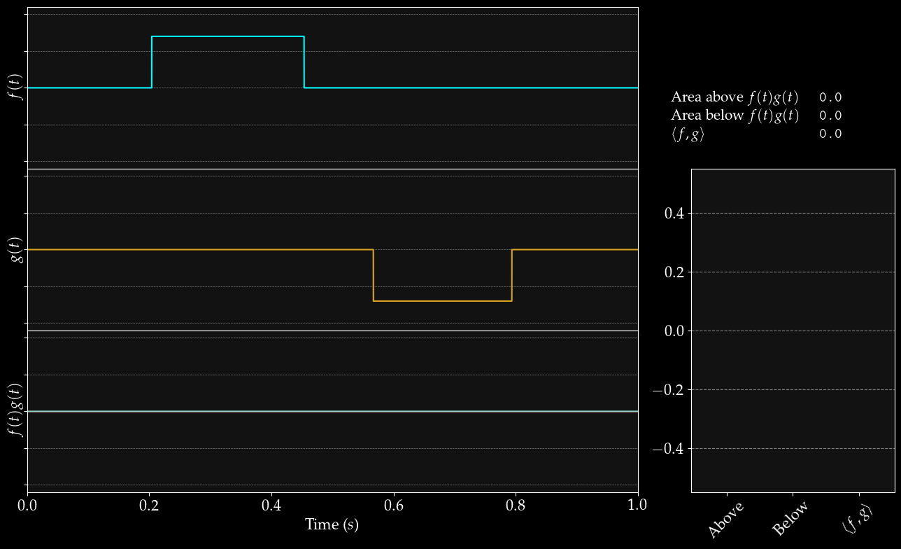

Slide 8
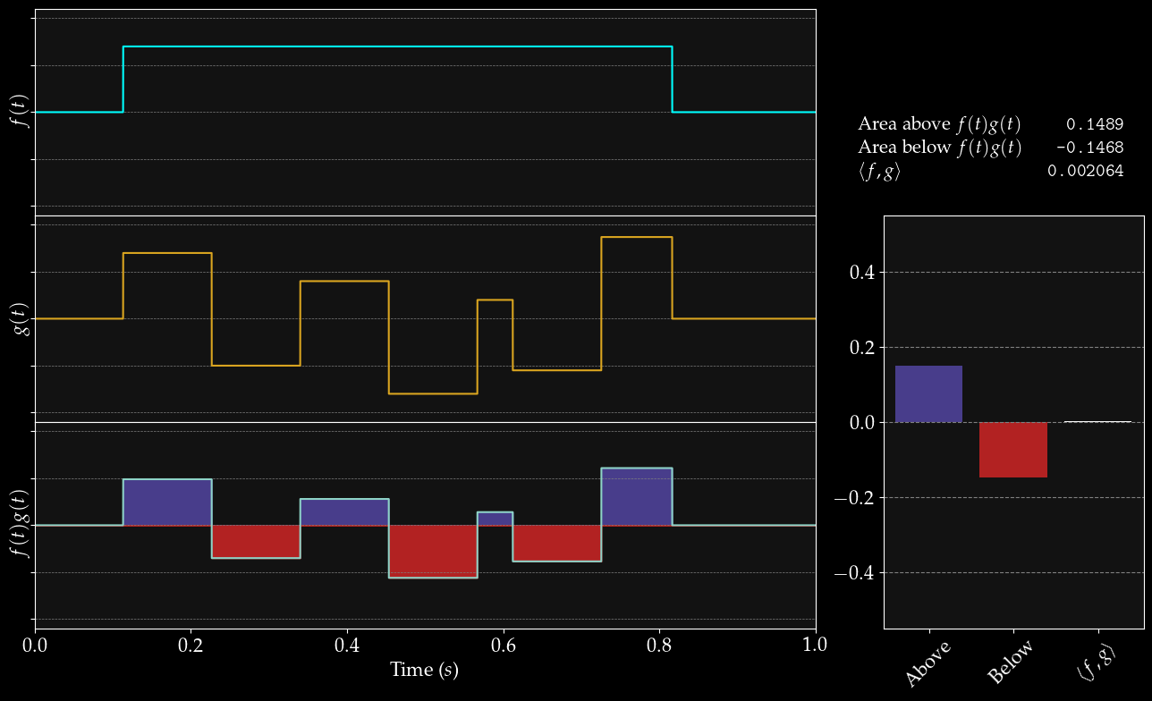

Slide 9
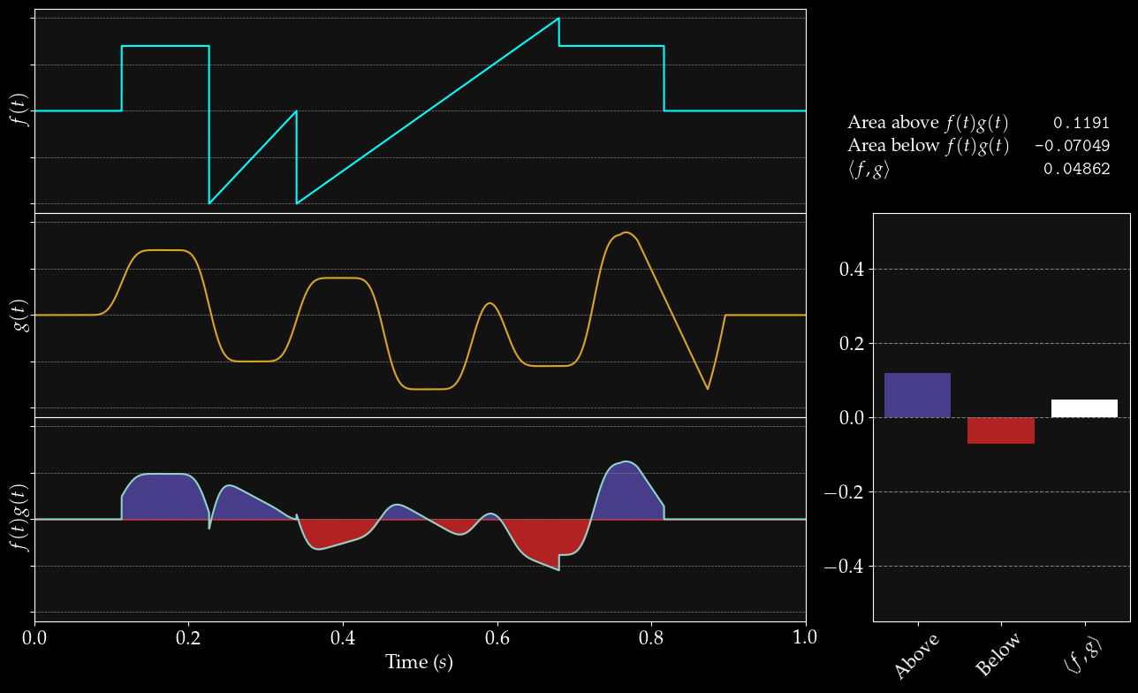

Slide 10
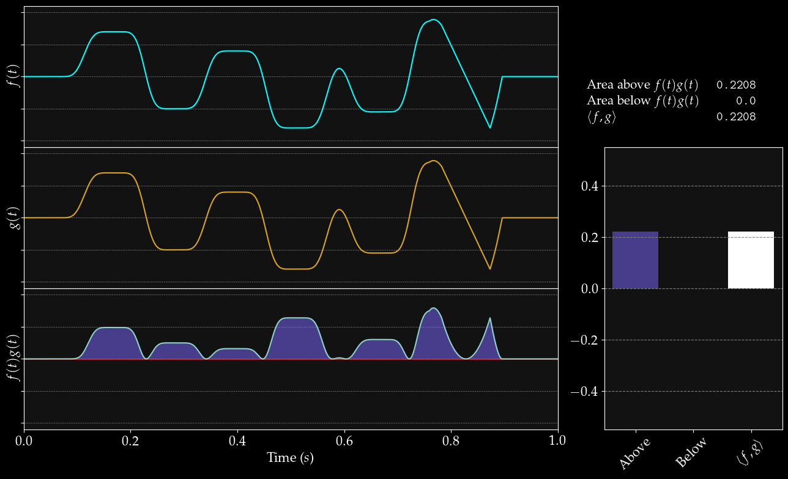

Slide 11
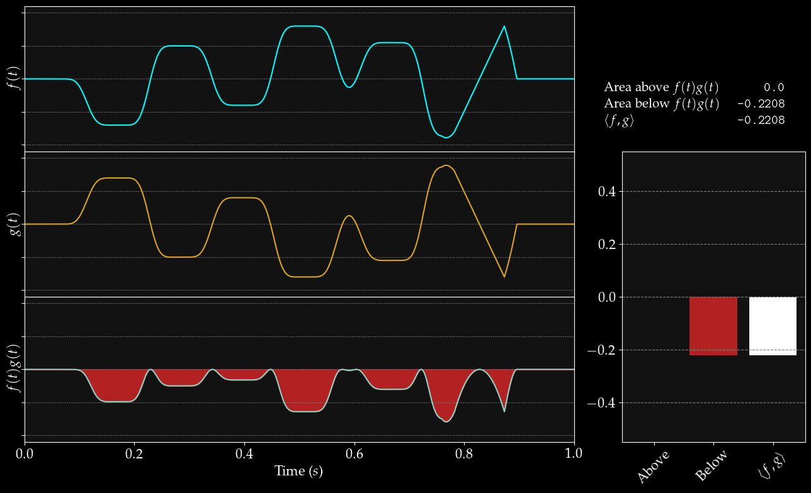

Slide 12
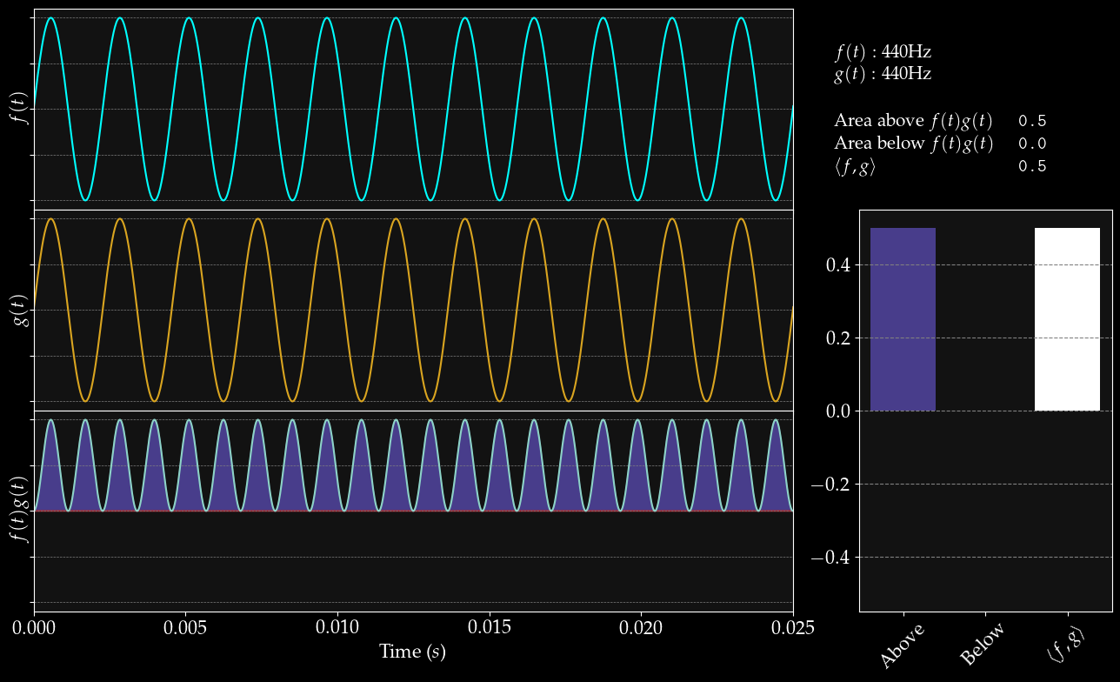

Slide 13
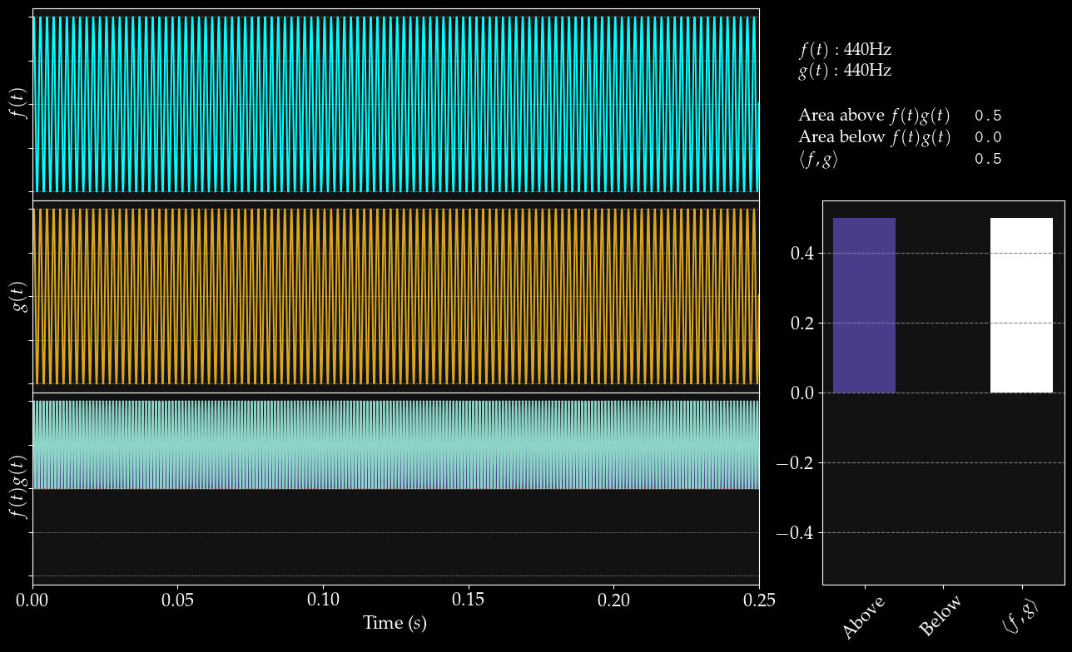
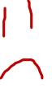

Slide 14
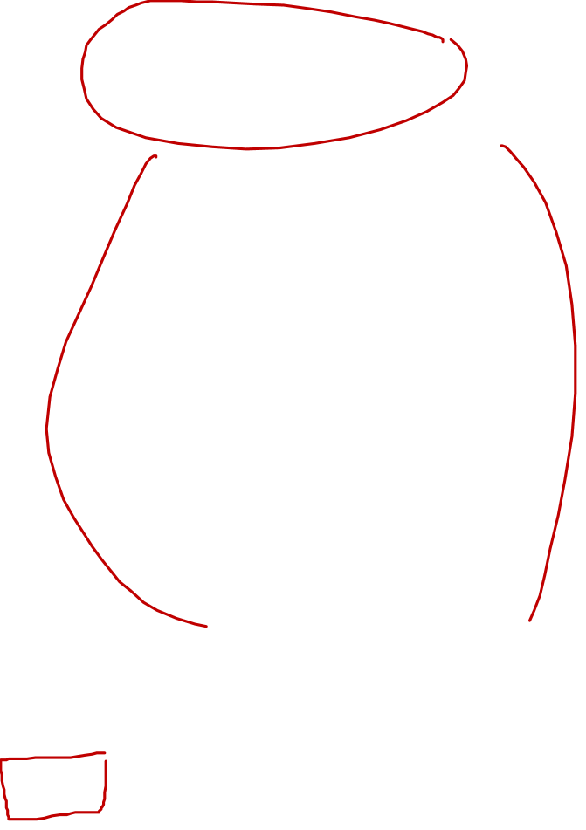

Slide 15
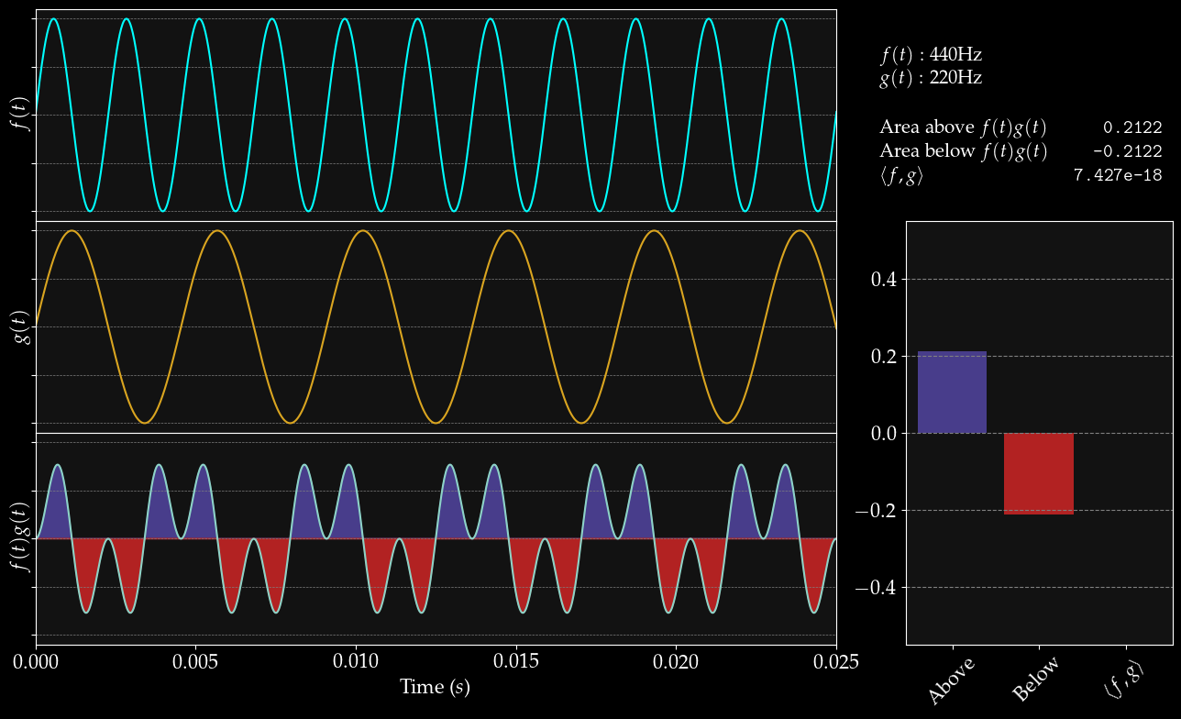


Slide 16
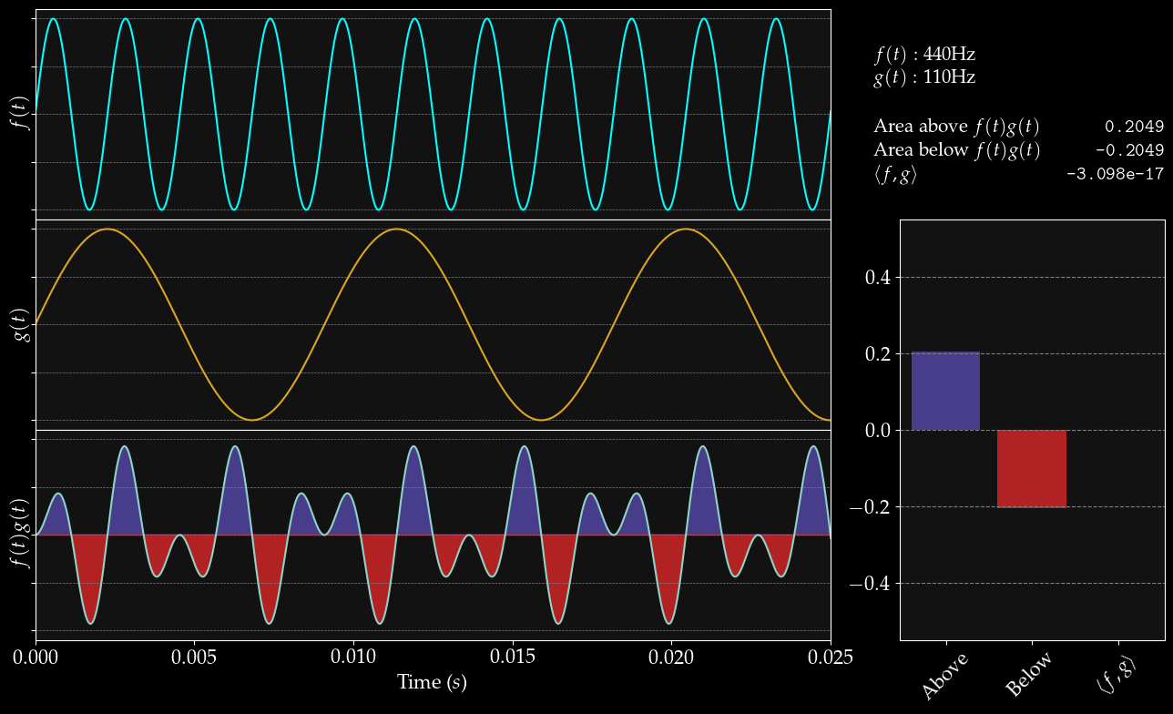

Slide 17
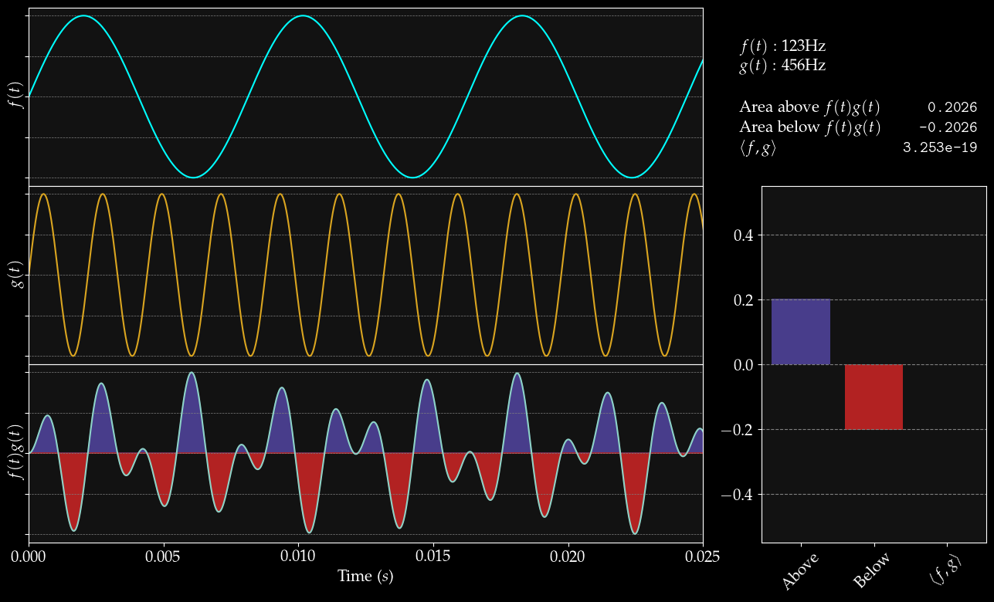

Slide 18
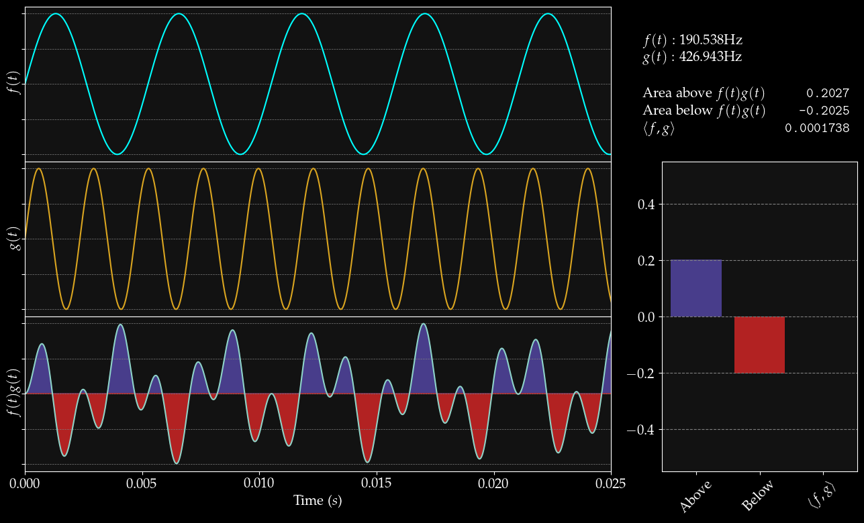

Slide 19
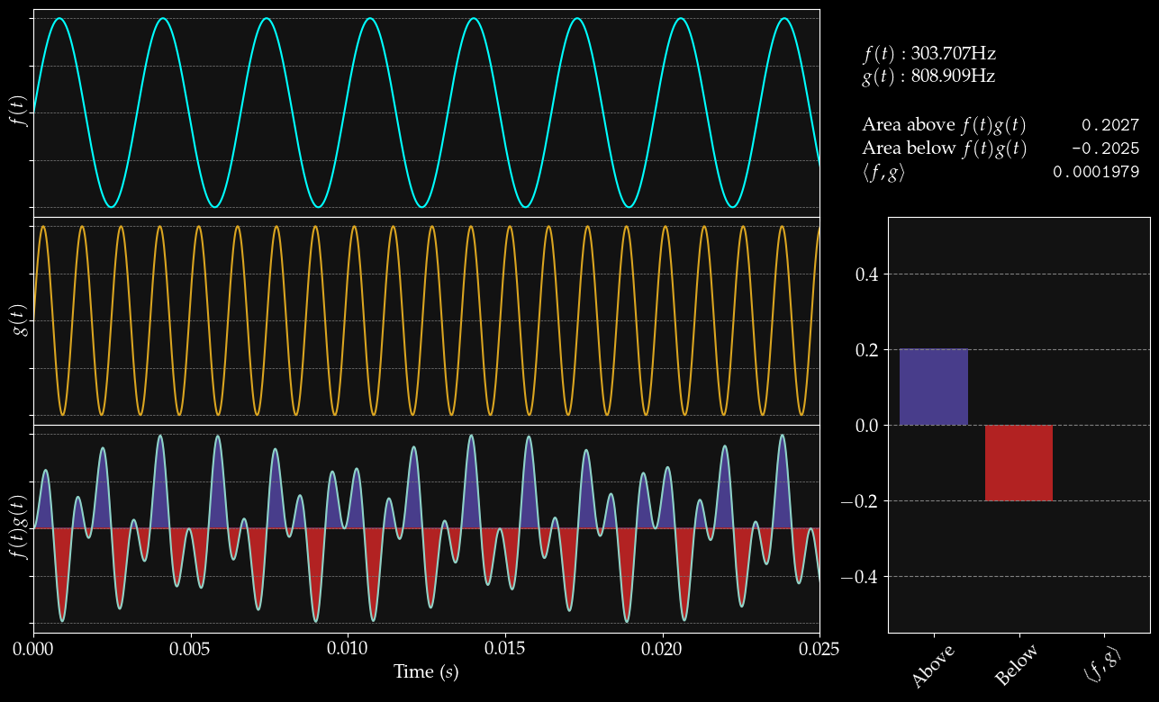

Slide 20
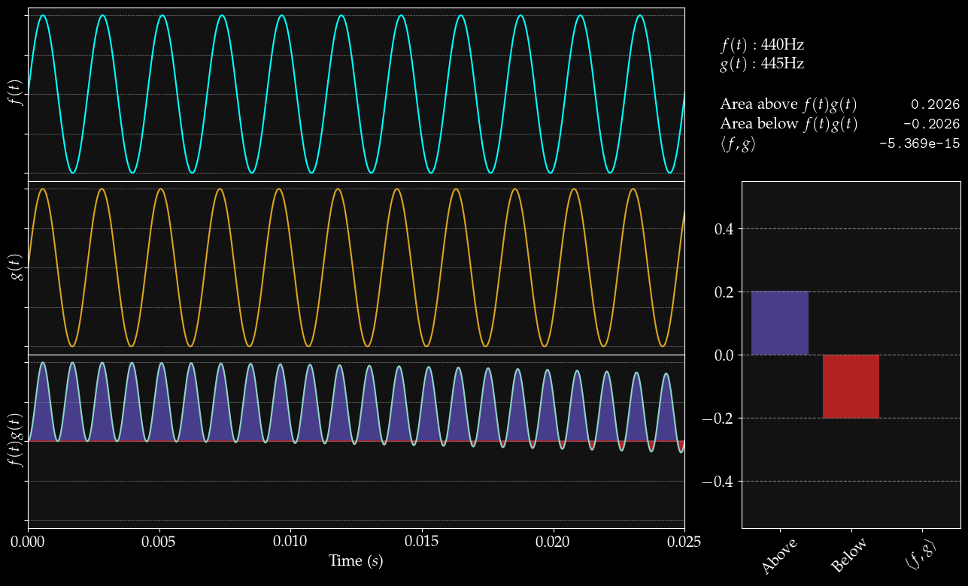

Slide 21
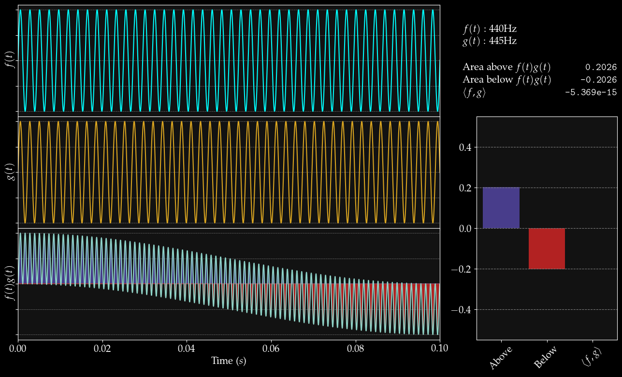

Slide 22
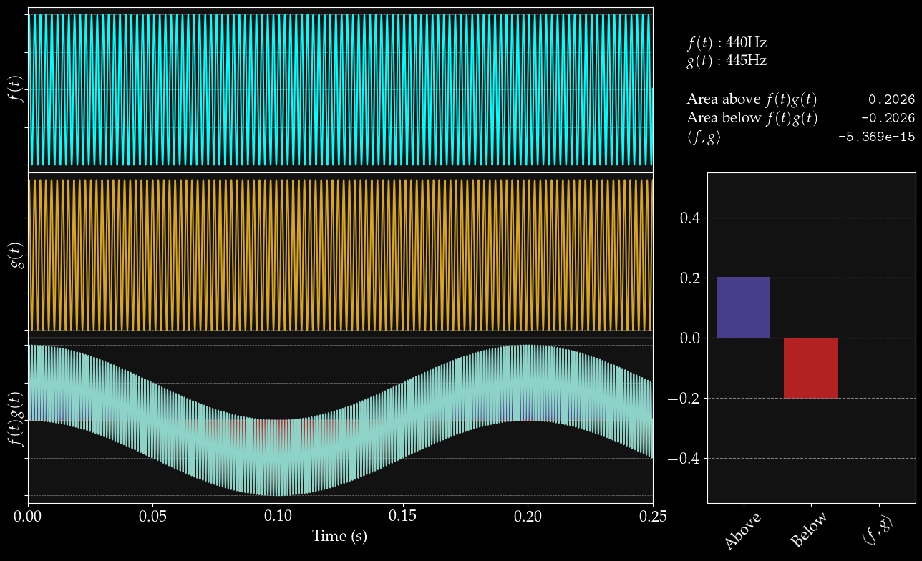

Slide 23
Notes:
\langle \sin(\theta_1) , sin(\theta_2) \rangle > 0 \iff \theta_1 = \theta_2

Slide 24

The inner product is linear
Notes:
\langle h + f, g \rangle &= \langle f, g \rangle + \langle h, g \rangle \\
\\
\langle f, g \rangle &= \int_{a}^{b} f(t) g(t) dt \\
\int_a^b [h(t) + f(t)] g(t) dt &= \int_{a}^{b} f(t) g(t) dt + \int_{a}^{b} h(t) g(t) dt\\
&= \int_{a}^{b} f(t) g(t) + h(t) g(t) dt\\
&= \int_a^b [h(t) + f(t)] g(t) dt \\

Slide 25
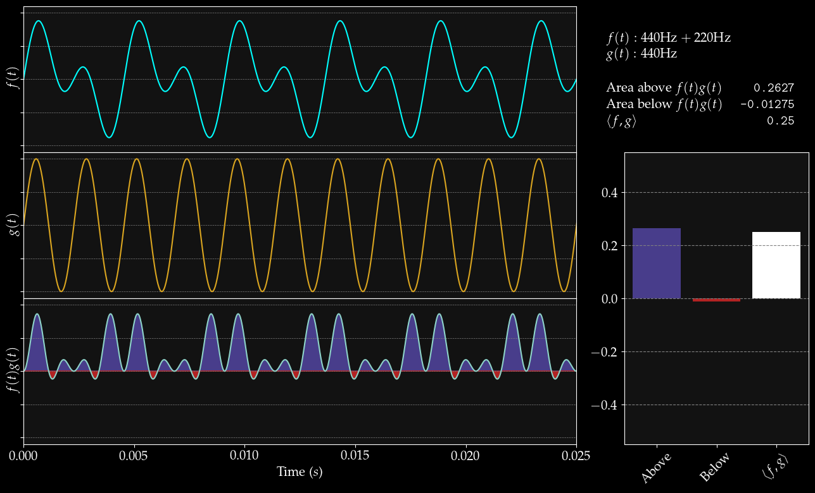

Slide 26

See, look, it works:
Notes:
\langle f, g \rangle &= \langle \sin(440t \cdot 2\pi) + \sin(220t \cdot 2\pi),\ \sin(440t \cdot 2\pi) \rangle \\
&= \langle \sin(440t \cdot 2\pi),\ \sin(440t \cdot 2\pi)\rangle + \langle \sin(440t \cdot 2\pi),\ \sin(220t \cdot 2\pi) \rangle \\
&= \langle \sin(440t \cdot 2\pi),\ \sin(440t \cdot 2\pi)\rangle \\
&= \int_0^L \sin(440t \cdot 2\pi) \cdot \sin(440t \cdot 2\pi) dt \\
&= \int_0^L \sin^2(440t \cdot 2\pi) dt > 0\\

Slide 27
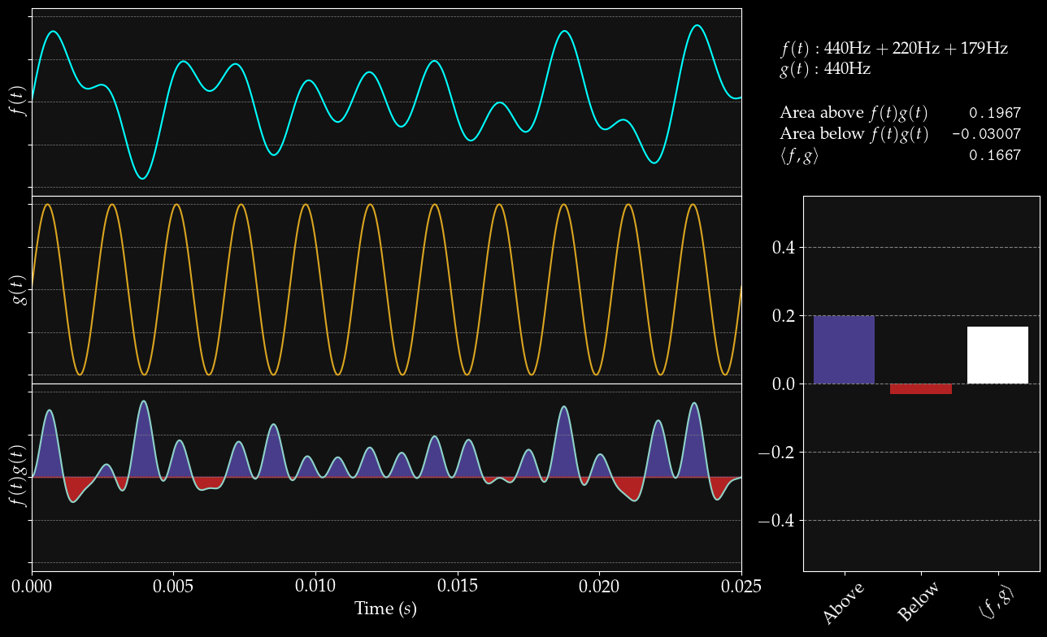

Slide 28
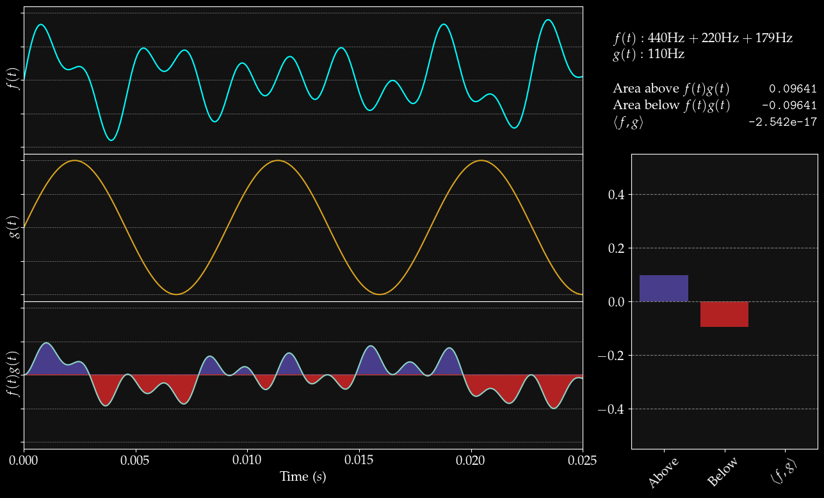

Slide 29
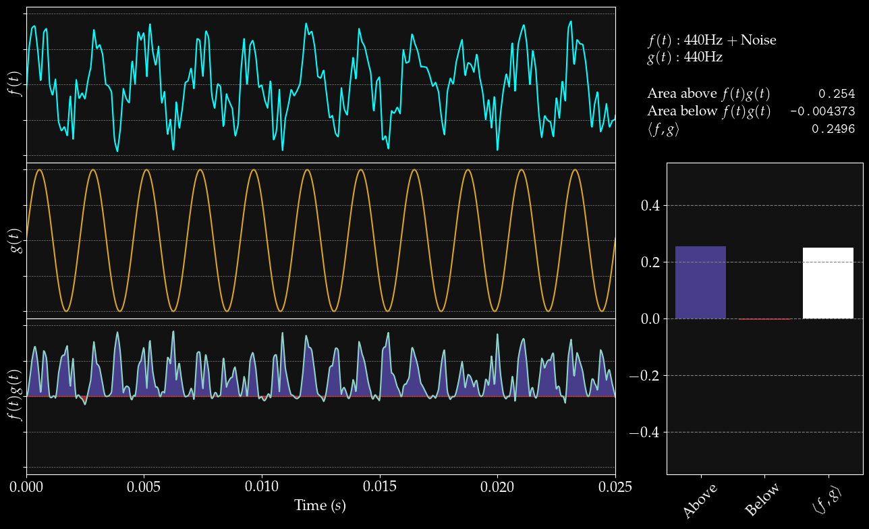

Slide 30
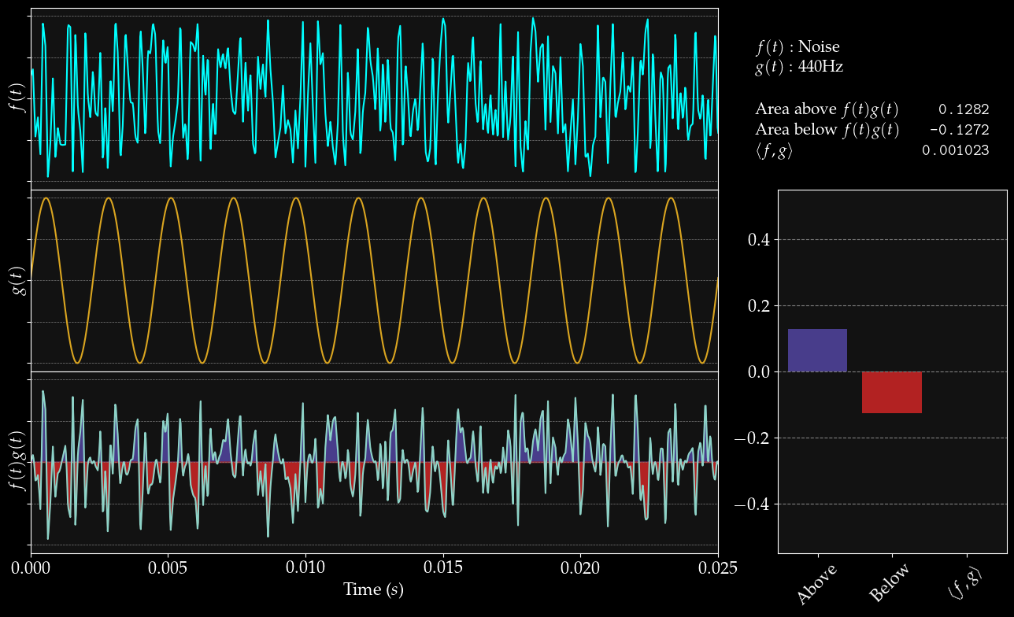

Slide 31
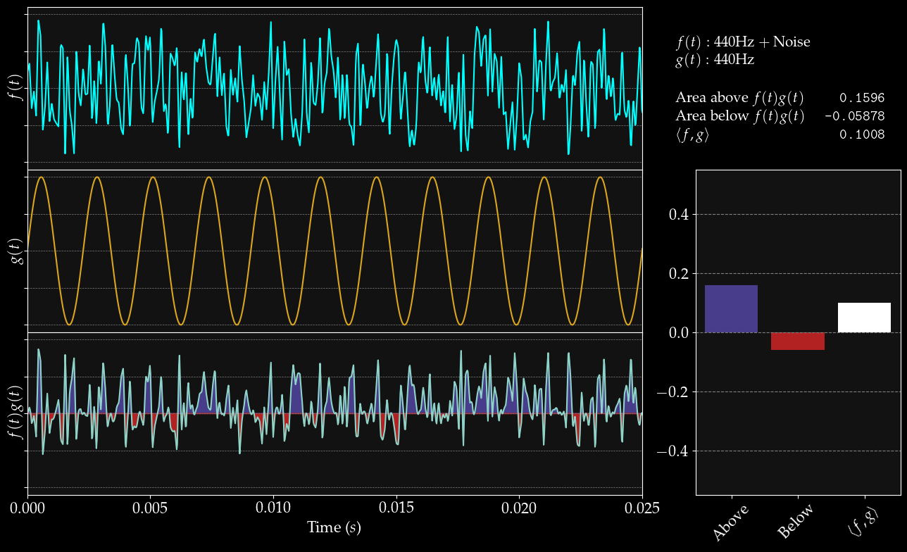

Slide 32
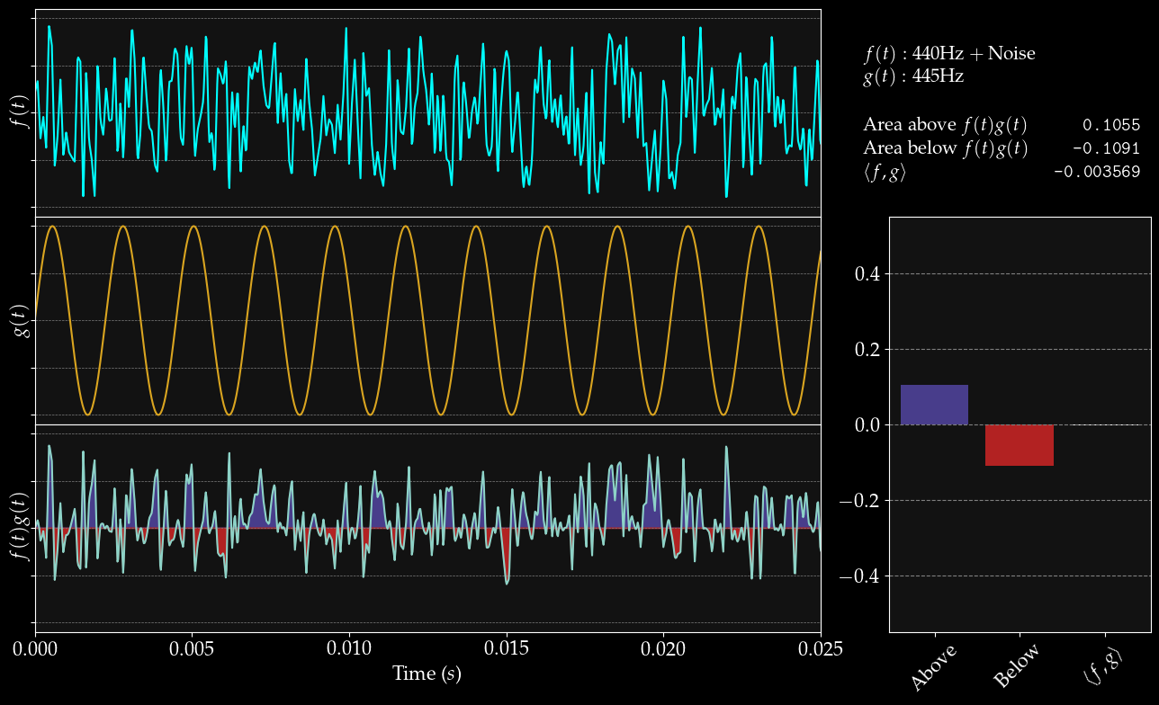

Slide 33

In the general case:
(r comprises all components of f at other frequencies)
Notes:
f &= \sin(\theta t \cdot 2\pi) + r(t) \\
\\
\langle f, g \rangle &= \langle \sin(\theta t \cdot 2\pi) + r(t),\ \sin(\theta t \cdot 2\pi) \rangle \\
&= \langle \sin(\theta t \cdot 2\pi),\ \sin(\theta t \cdot 2\pi) \rangle + \langle \sin(\theta t \cdot 2\pi),\ r(t) \rangle \\
&= \langle \sin(\theta t \cdot 2\pi),\ \sin(\theta t \cdot 2\pi) \rangle \\
&> 0

Slide 34
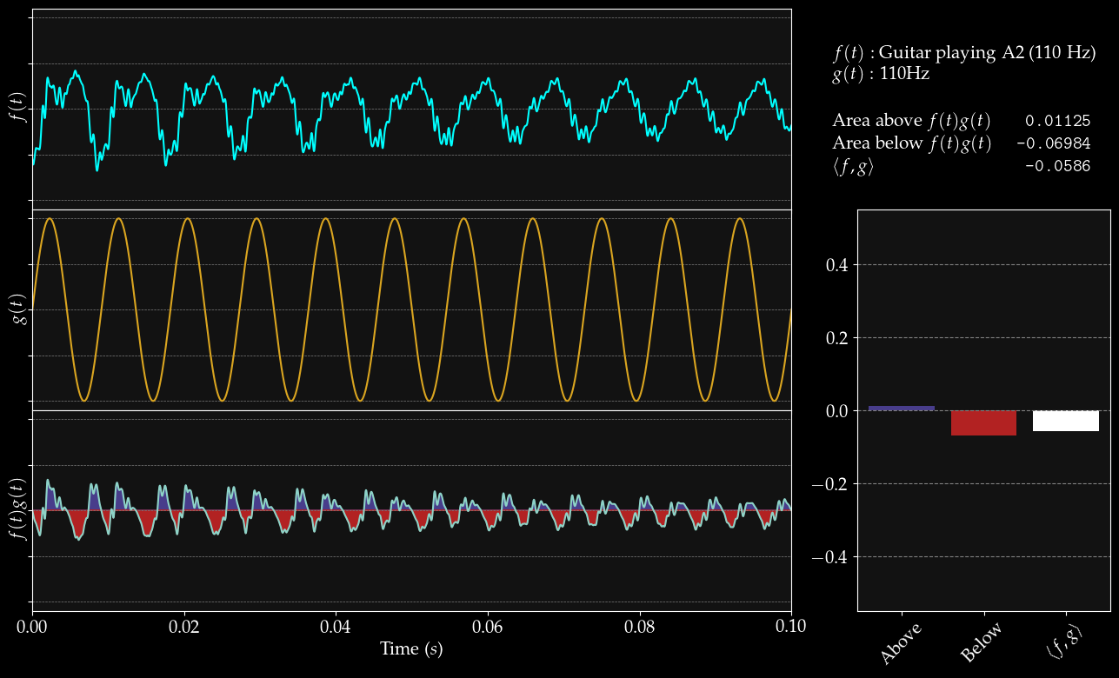

Slide 35
I have lied to you :(
I mean, you didn’t think it’d be that easy, did you?

Slide 36
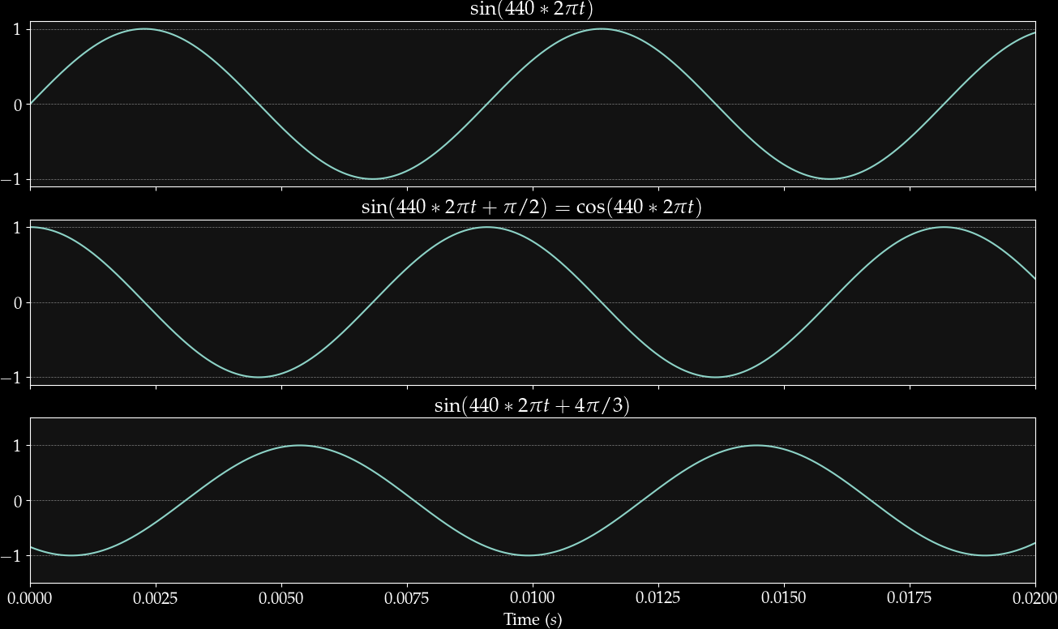

Slide 37
Notes:
\langle \sin(\theta_1),\ \sin(\theta_2) \rangle > 0 &\iff \theta_1 = \theta_2 \\
\langle \sin(\theta_1 + \phi_1),\ \sin(\theta_2 + \phi_2) \rangle > 0 &\iff \theta_1 = \theta_2\ \mathrm{and}\ \phi_1 = \phi_2 \\

Slide 38
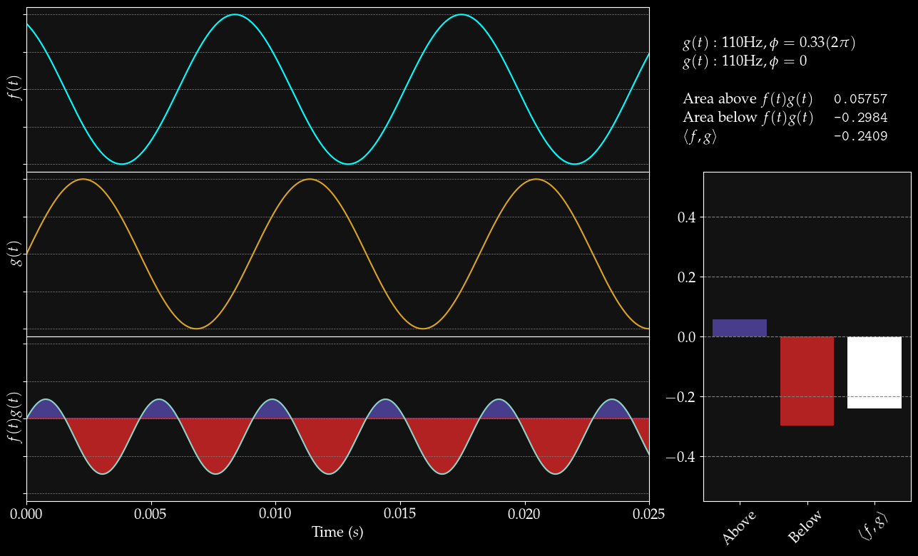

Slide 39
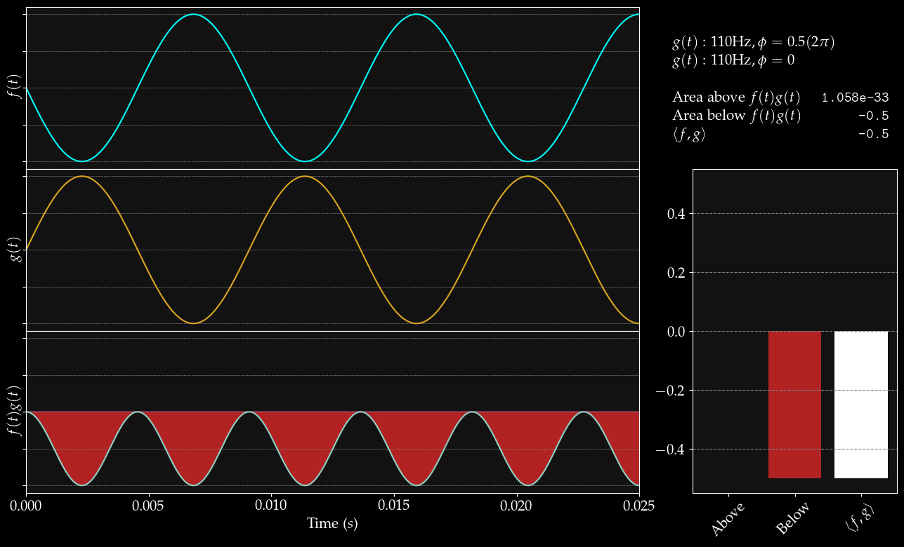

Slide 40
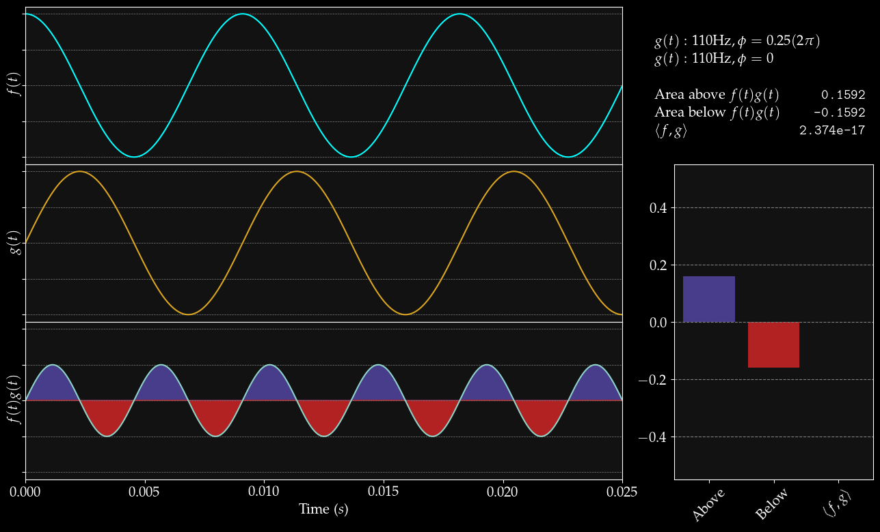

Slide 41
Solution:
Represent the sine wave we’re looking for (which has a phase we don’t know) as a sum of two waves whose phases we do know.
Find those two waves instead!

Slide 42
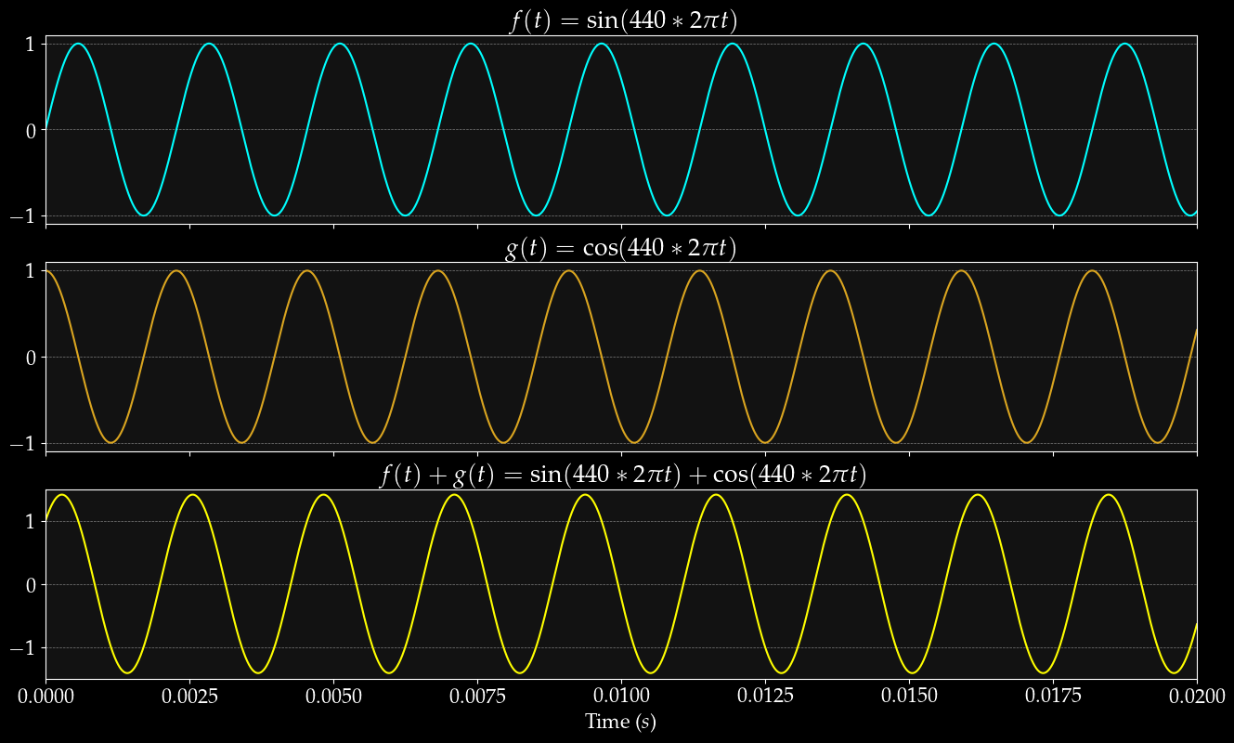

Slide 43

Harmonic Addition Theorem
Amplitude
Phase
Prove it yourself:
Notes:
a\sin(x) + b\cos(x) &= \sqrt{a^2 + b^2}\sin\left( x + \arctan \left[ \frac{b}{a} \right] \right)\\
\\
\sin(\alpha + \beta) &= \sin(\alpha)\cos(\beta) + \sin(\beta)\cos(\alpha)

Slide 44

The inner product of Sine and Cosine is 0!
That is: they are orthogonal.

Slide 45
Same sign
Different sign

Slide 46

Using two waves to find one wave
Notes:
f(t) &= \sin(\theta t + \phi) + r(t) \\
\langle f, g\rangle &= \langle \sin(\theta t + \phi) + r(t), g(t) \rangle \\
\langle f, g\rangle &= \langle a\sin(\theta t) + b\cos(\theta t) + r(t), g(t) \rangle \\
\langle f, g\rangle &= \langle a\sin(\theta t), g(t) \rangle + \langle b\cos(\theta t), g(t) \rangle + \langle r(t), g(t) \rangle \\
\\
\mathrm{Let\ } g_1(t) &= \sin(\theta t): \\
\langle f, g_1\rangle &= \langle a\sin(\theta t), \sin(\theta t) \rangle + \langle b\cos(\theta t), \sin(\theta t)\rangle + \langle r(t), \sin(\theta t) \rangle \\
\langle f, g_1\rangle &= \langle a\sin(\theta t), \sin(\theta t) \rangle \\
\langle f, g_1\rangle &= a \langle \sin(\theta t), \sin(\theta t) \rangle \\
\\
\mathrm{Let\ } g_2(t) &= \cos(\theta t): \\
\langle f, g_2\rangle &= \langle a\sin(\theta t), \cos(\theta t) \rangle + \langle b\cos(\theta t), \cos(\theta t)\rangle + \langle r(t), \cos(\theta t) \rangle \\
\langle f, g_2\rangle &= \langle b\cos(\theta t), \cos(\theta t) \rangle \\
\langle f, g_2\rangle &= b \langle \cos(\theta t), \cos(\theta t) \rangle \\

Slide 47
Using two waves to find one wave
Notes:
f(t) &= \sin(\theta t + \phi) + r(t) \\
\langle f, g\rangle &= \langle \sin(\theta t + \phi) + r(t), g(t) \rangle \\
\langle f, g\rangle &= \langle a\sin(\theta t) + b\cos(\theta t) + r(t), g(t) \rangle \\
\langle f, g\rangle &= \langle a\sin(\theta t), g(t) \rangle + \langle b\cos(\theta t), g(t) \rangle + \langle r(t), g(t) \rangle \\
\\
\mathrm{Let\ } g_1(t) &= \sin(\theta t): \\
\langle f, g_1\rangle &= \langle a\sin(\theta t), \sin(\theta t) \rangle + \langle b\cos(\theta t), \sin(\theta t)\rangle + \langle r(t), \sin(\theta t) \rangle \\
\langle f, g_1\rangle &= \langle a\sin(\theta t), \sin(\theta t) \rangle \\
\langle f, g_1\rangle &= a \langle \sin(\theta t), \sin(\theta t) \rangle \\
\\
\mathrm{Let\ } g_2(t) &= \cos(\theta t): \\
\langle f, g_2\rangle &= \langle a\sin(\theta t), \cos(\theta t) \rangle + \langle b\cos(\theta t), \cos(\theta t)\rangle + \langle r(t), \cos(\theta t) \rangle \\
\langle f, g_2\rangle &= \langle b\cos(\theta t), \cos(\theta t) \rangle \\
\langle f, g_2\rangle &= b \langle \cos(\theta t), \cos(\theta t) \rangle \\

Slide 48

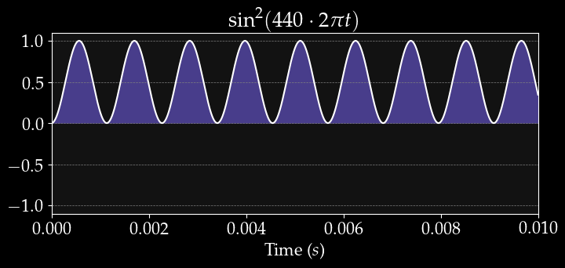
Okay, let me justify that…
Assuming the inner product is equal to a => scaling a up by L
Notes:
\langle f, g_1\rangle &= a \langle \sin(\theta t), \sin(\theta t) \rangle \\
&= a \int_0^L \sin(\theta t)\sin(\theta t) dt\\
&= a \int_0^L \sin^2(\theta t) dt\\
&= a\left[ \frac{L}{2} - \frac{1}{4}\sin(2L) \right]\\
&\approx \frac{L}{2}a \\

Slide 49
Using two waves to find one wave

Slide 50

Put all together:
Amplitude
Phase
Notes:
f(t) &= \sin(\theta t + \phi) + r(t) \\
\langle f, g\rangle &= \langle \sin(\theta t + \phi) + r(t), g(t) \rangle \\
\langle f, g\rangle &= \langle a\sin(\theta t) + b\cos(\theta t) + r(t), g(t) \rangle \\
\langle f, g\rangle &= \langle a\sin(\theta t), g(t) \rangle + \langle b\cos(\theta t), g(t) \rangle + \langle r(t), g(t) \rangle \\
\\
\mathrm{Let\ } g_1(t) &= \sin(\theta t): \\
\langle f, g_1\rangle &= \langle a\sin(\theta t), \sin(\theta t) \rangle + \langle b\cos(\theta t), \sin(\theta t)\rangle + \langle r(t), \sin(\theta t) \rangle \\
\langle f, g_1\rangle &= \langle a\sin(\theta t), \sin(\theta t) \rangle \\
\langle f, g_1\rangle &= a \langle \sin(\theta t), \sin(\theta t) \rangle \\
\\
\mathrm{Let\ } g_2(t) &= \cos(\theta t): \\
\langle f, g_2\rangle &= \langle a\sin(\theta t), \cos(\theta t) \rangle + \langle b\cos(\theta t), \cos(\theta t)\rangle + \langle r(t), \cos(\theta t) \rangle \\
\langle f, g_2\rangle &= \langle b\cos(\theta t), \cos(\theta t) \rangle \\
\langle f, g_2\rangle &= b \langle \cos(\theta t), \cos(\theta t) \rangle \\

Slide 51
Previous Strategy:
Take inner product of signal with one sine wave at frequency θ
Result = amplitude of that sine wave as a component of original signal
(Fails when we don’t know the phase of the component)
New Strategy:
Take inner product of signal with two waves at frequency θ, one sine and one cosine
Use resulting values (a, b) to derive amplitude and phase of that frequency in original signal
(Succeeds without phase information and finds phase in the process!)

Slide 52
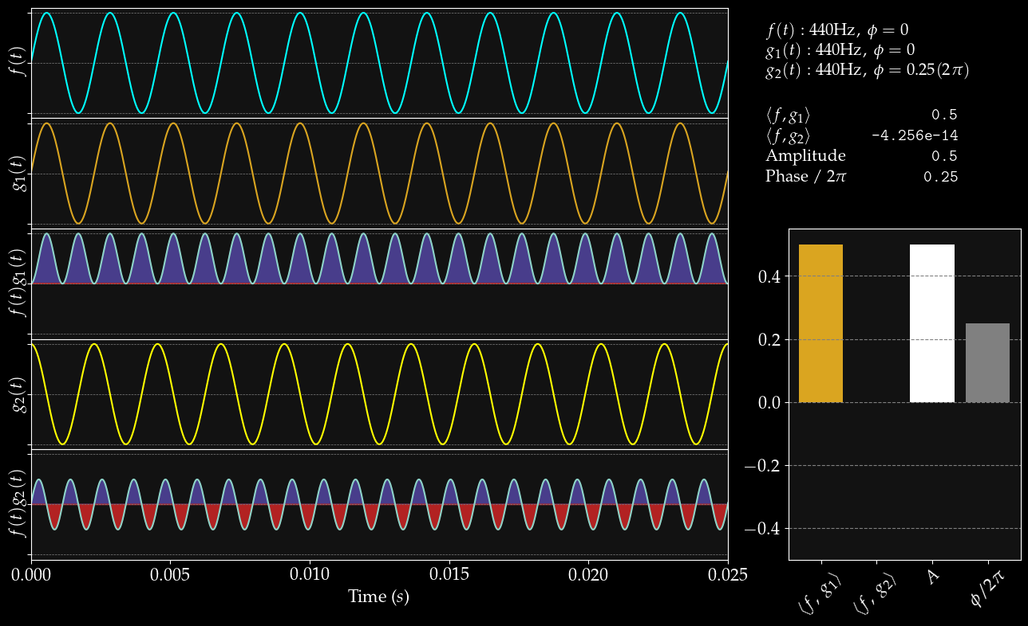

Slide 53
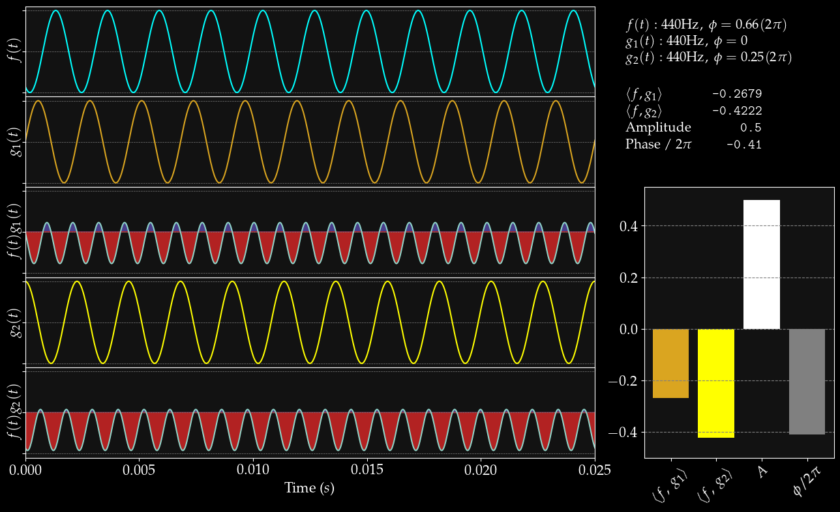

Slide 54
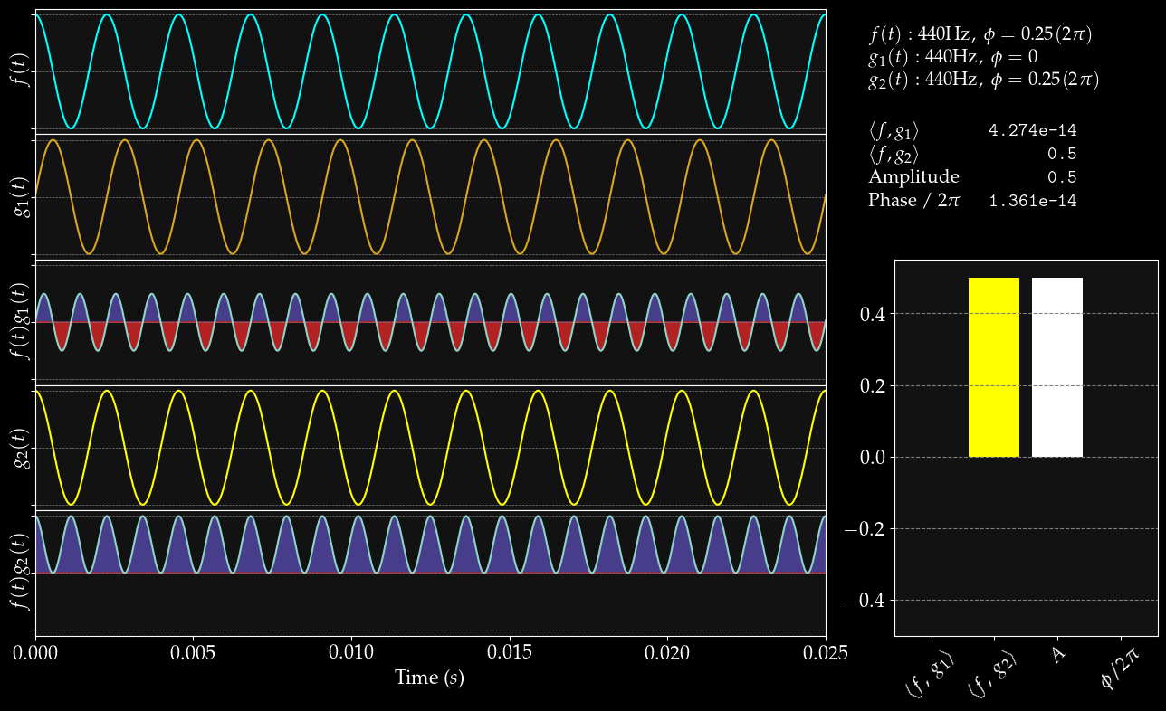

Slide 55
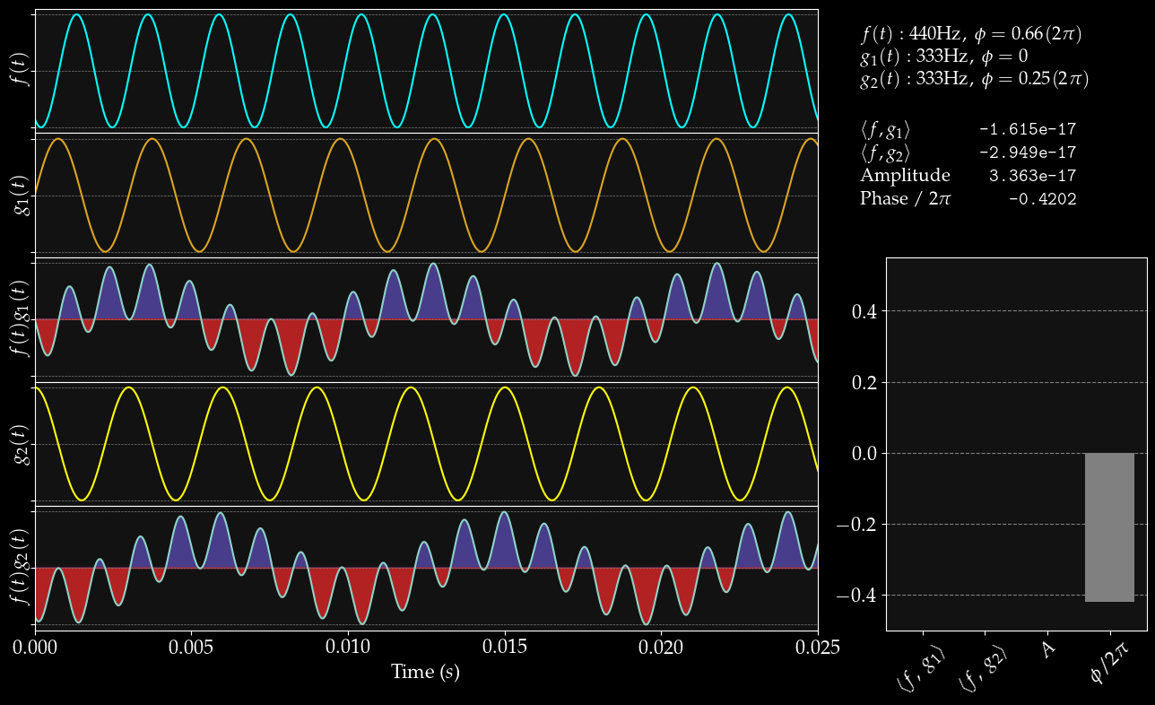

Slide 56
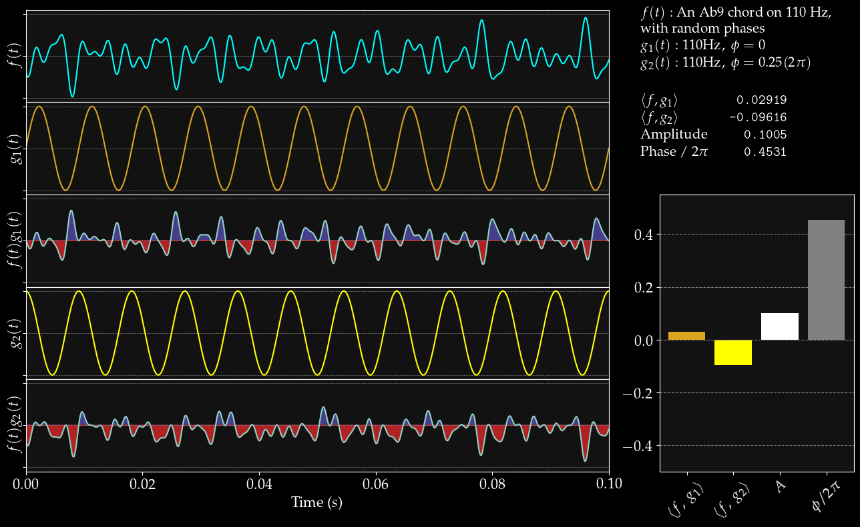

Slide 57
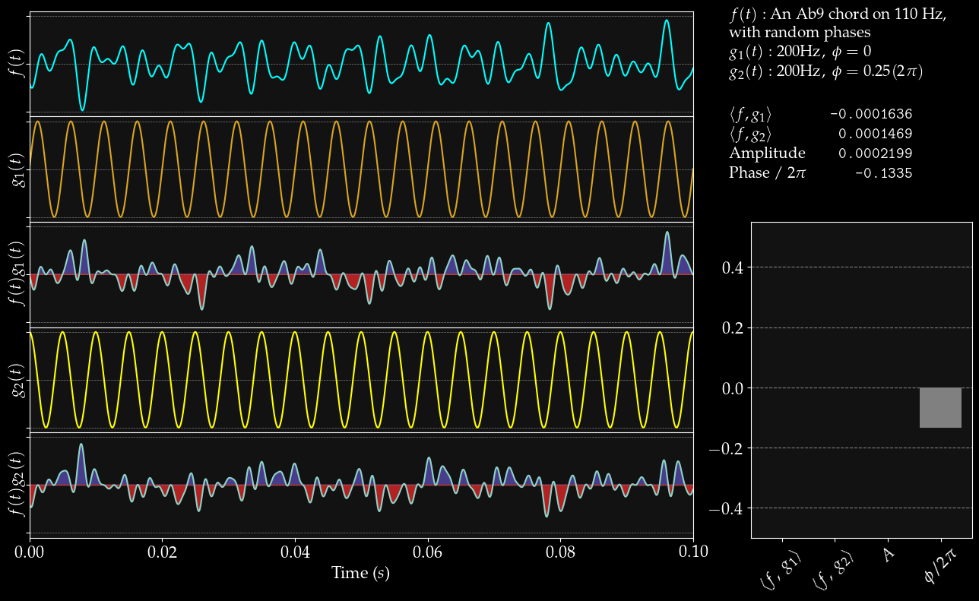

Slide 58
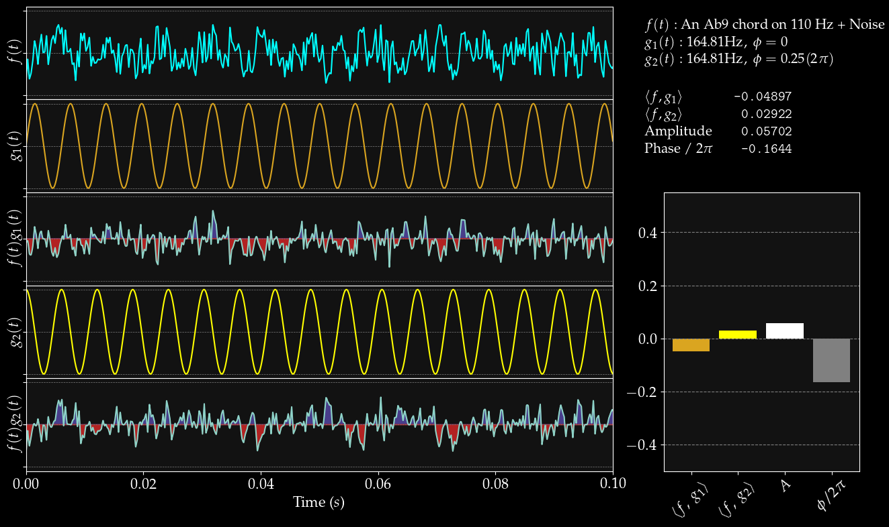

Slide 59
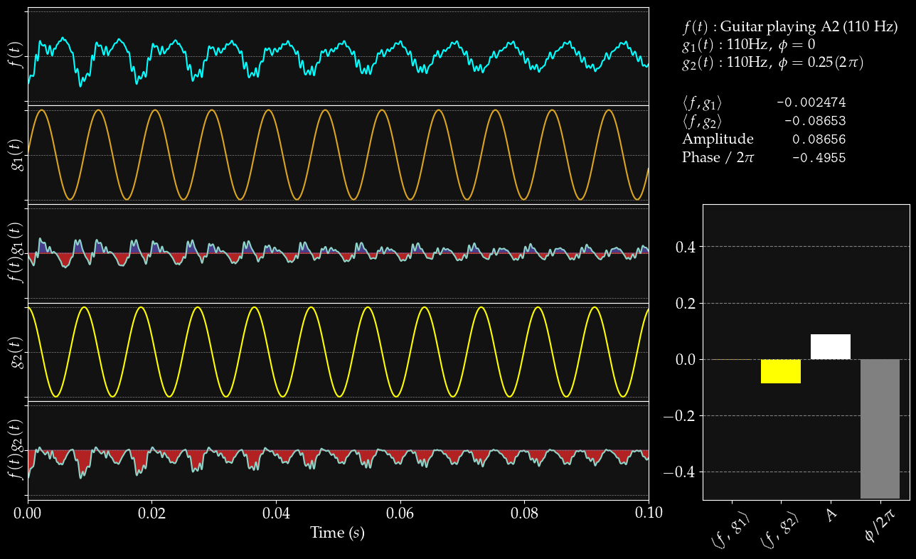

Slide 60
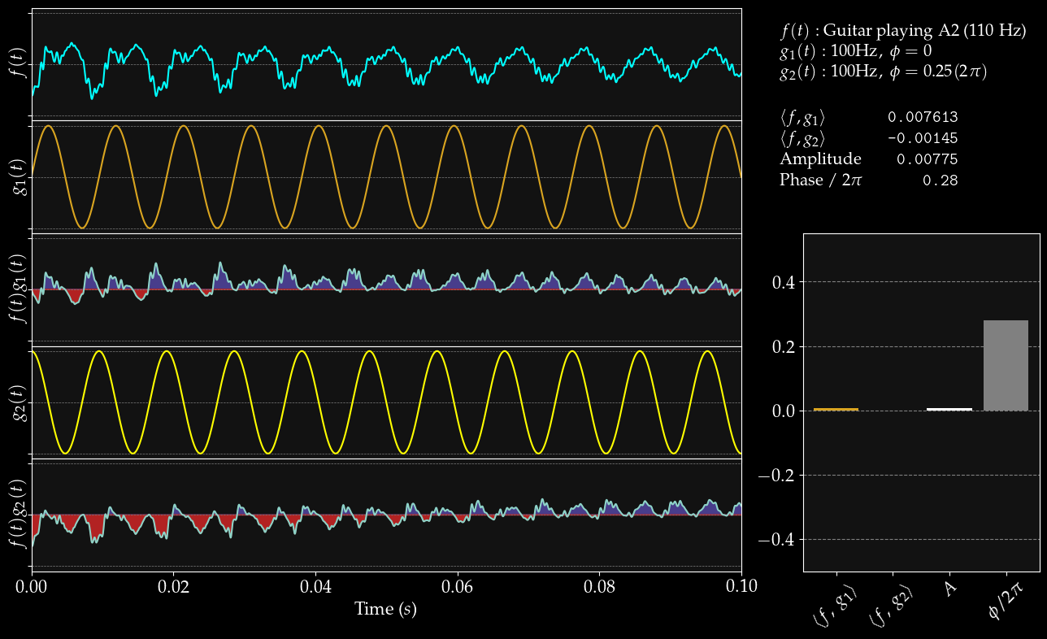

Slide 61
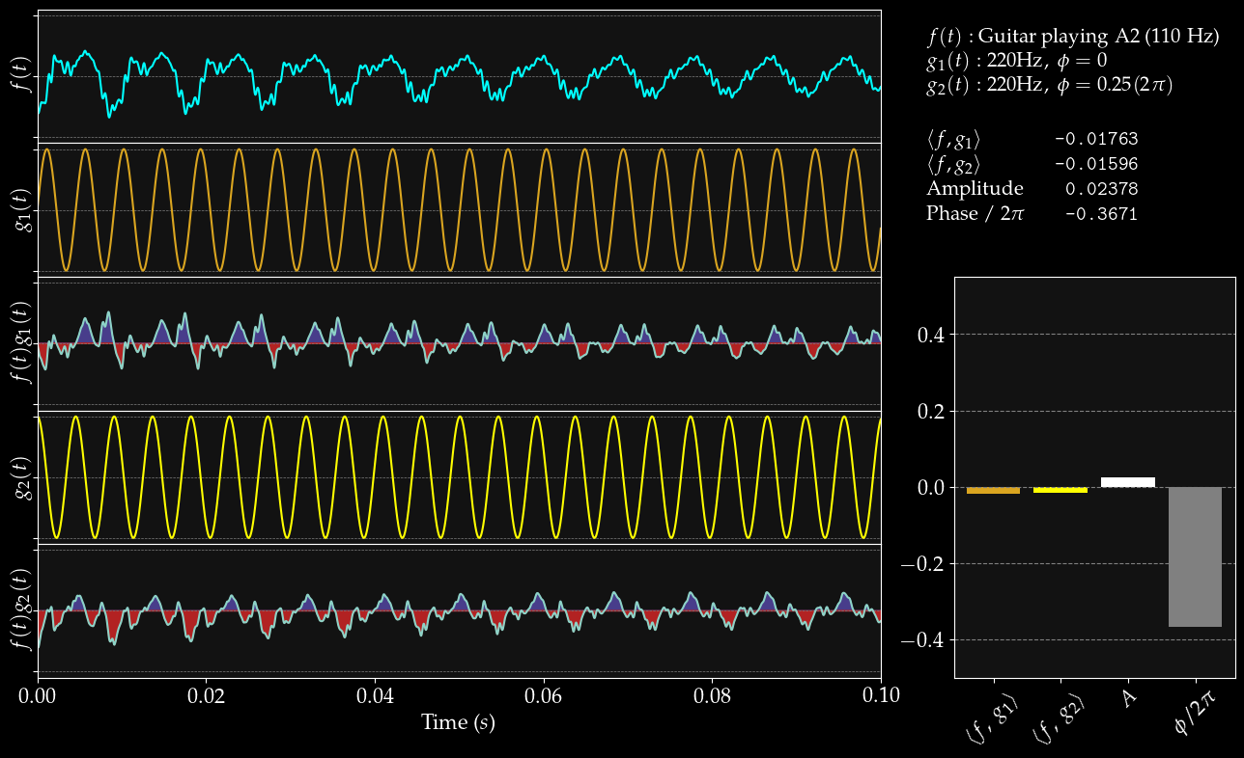

Slide 63
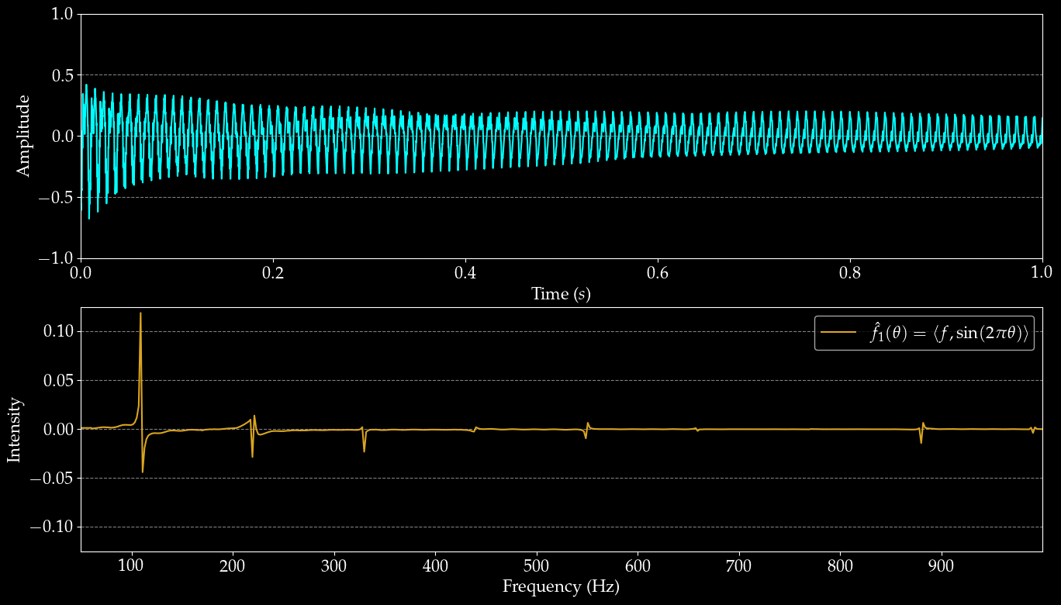

Slide 64
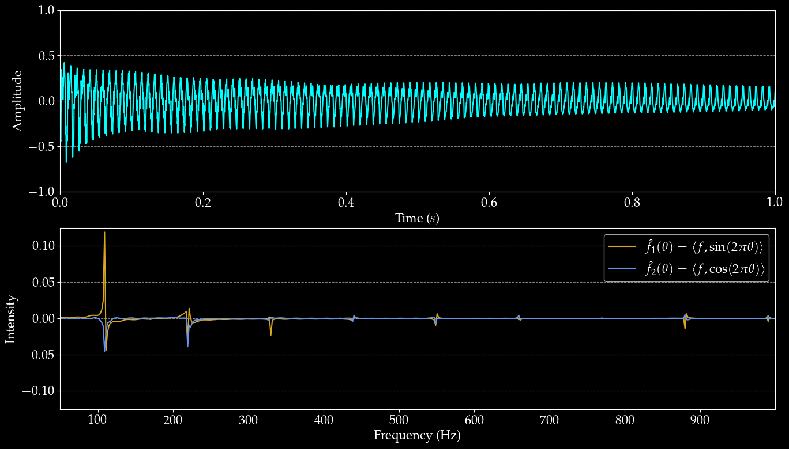

Slide 65
wait what
That’s the Fourier Transform!

Slide 66

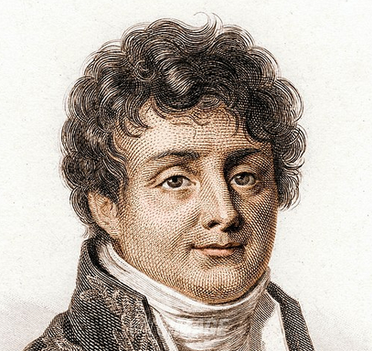
Who needs complex numbers anyway?
The Sine and Cosine Transforms

Slide 67
The Fourier Transform (Finally)
Imaginary part of Fourier Transform
Real part of Fourier Transform
Hey, that’s just Euler’s Formula…

Slide 68


